Slide 1

Chord Protocol Lib
Daverio - Lagni
Pietro Daverio
Luca Lagni
POLITECNICO DI MILANO

Slide 2

Objectives and Constraints
Daverio - Lagni
Implementation of Chord Library as described in paper: Chord: A Scalable Peer-to-peer Lookup Protocol for Internet Applications
Implementation of an application sample that uses chord Library
Language: Java
“ Abstract— A fundamental problem that confronts peer-to-peer applications is the efficient location of the node that stores a desired data item. This paper presents Chord, a distributed lookup protocol that addresses this problem. Chord provides support for just one operation: given a key, it maps the key onto a node. Data location can be easily implemented on top of Chord by associating a key with each data item, and storing the key/data pair at the node to which the key maps. Chord adapts efficiently as nodes join and leave the system, and can answer queries even if the system is continuously changing. Results from theoretical analysis and simulations show that Chord is scalable: communication cost and the state maintained by each node scale logarithmically with the number of Chord nodes. “
POLITECNICO DI MILANO

Slide 3
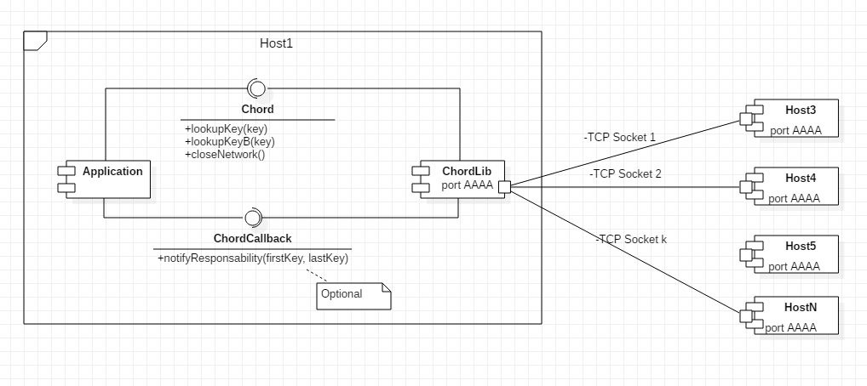
Components and interfaces
Daverio - Lagni
Overview of components interactions on an host and connections between nodes
.
.
.
POLITECNICO DI MILANO

Slide 4
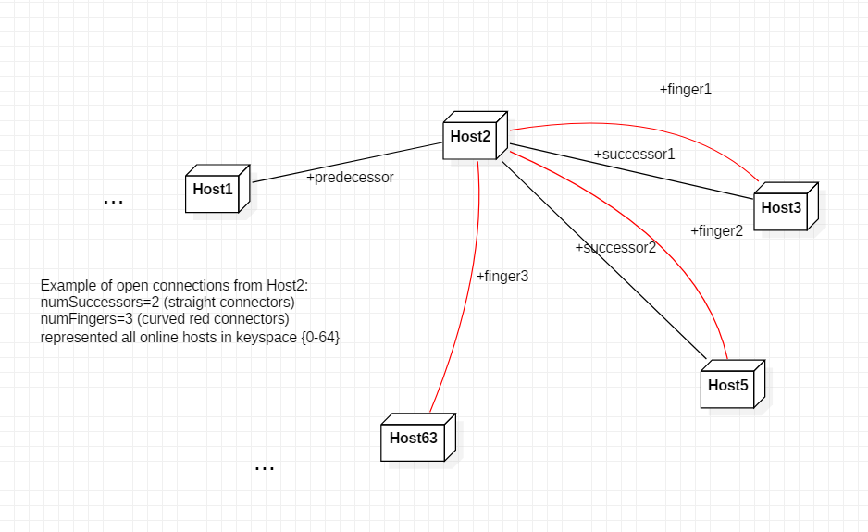
Successors and Fingers Example
Daverio - Lagni
.
.
.
POLITECNICO DI MILANO

Slide 5
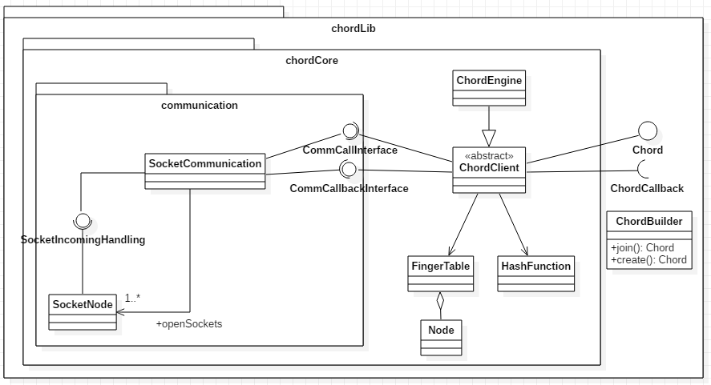
ChordLib class diagram
Daverio - Lagni
Overview of main classes and interfaces (only elements in chordLib are exposed)
.
.
.
POLITECNICO DI MILANO

Slide 6
Implementation choices
Daverio - Lagni
Number of successors and fingers are parametrized
Can be set the number of Lookup retrial to mask transient faults
Period for routines is parametrized
Efficient handling in case of voluntary node departure
Fault tolerant up to nSuccessors adiacent faults
In case of a node fault, correctness is not guaranteed before the next execution of routine actions: chord will return the IP of faulted node (if it was responsible for the key)
.
.
.
POLITECNICO DI MILANO

Slide 7
Implementation choices
Daverio - Lagni
Invocations on ChordLib component (Chord interface) are synchronous (Caller is suspended until response is returned or error arise)
ChordLib can handle multiple lookup at the same time, requests are processed in parallel and run out of order
ChordLib is configured to run both on a LAN or internet (configuring Port Forwarding for incoming connections)
ChordLib can handle multiple ChordNetworks on different socketPorts
Communication via TCP Sockets, other communication mechanisms can be added extending interfaces defined in communication package
SHA-1 hashing for keys, other mechanisms can be added extending chordLib/chordCore/HashFunction class
.
.
.
POLITECNICO DI MILANO

Slide 8
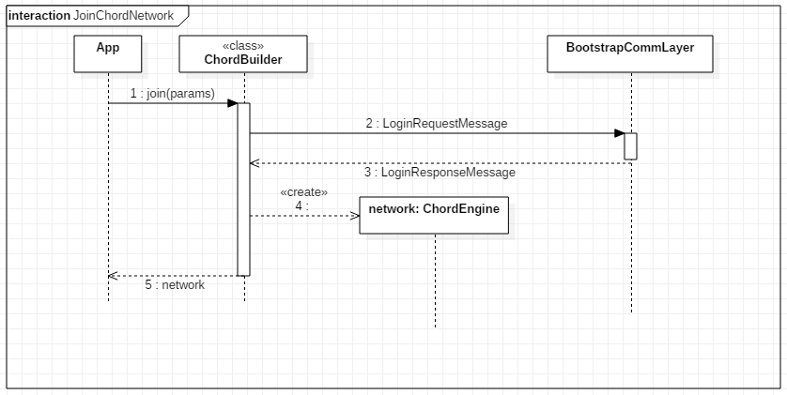
Join operation
Daverio - Lagni
.
.
.
POLITECNICO DI MILANO

Slide 9
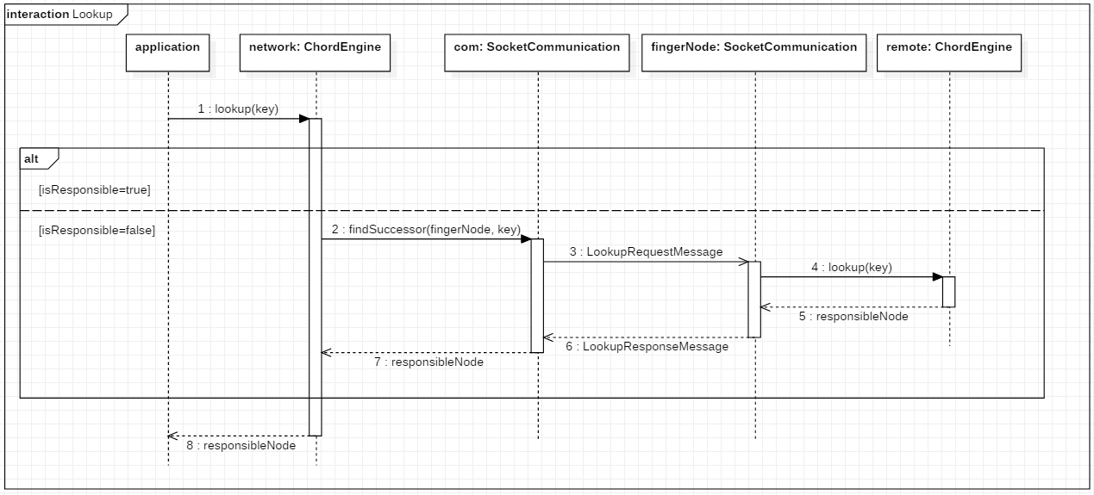
Lookup operation
Daverio - Lagni
.
.
.
POLITECNICO DI MILANO

Slide 10
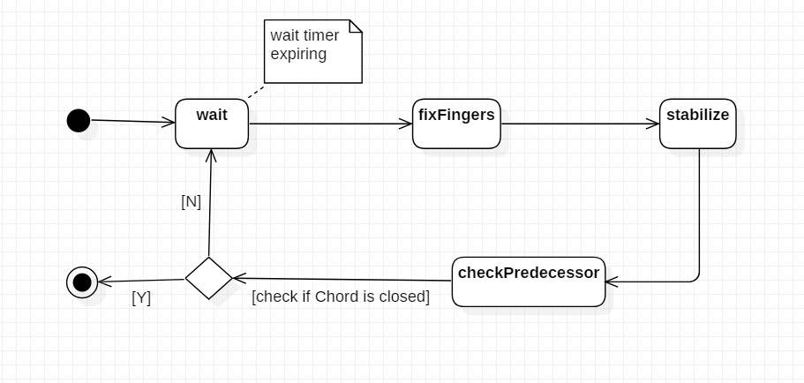
Periodic Routines
Daverio - Lagni
.
.
.
POLITECNICO DI MILANO

